Slide 1

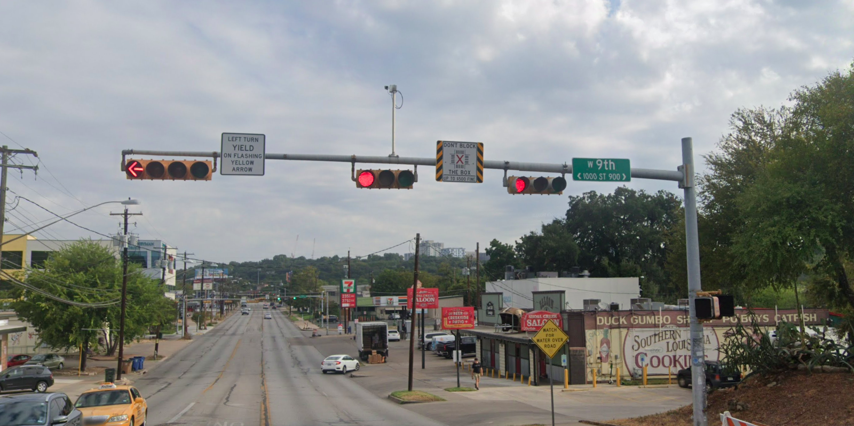
Austin Transportation Department Signs Work Orders
Created By: Susanne Gov Created Date: 2020-08-10 Location Name: LAMAR BLVD / 9TH ST Intersection ID: 5155448 Cardinal Direction: N
Sign Type | Install/Remove
Left Turn Yield Flashing Yellow | Remove
Street Name Sign | Install
Don’t Block the Box | Install

Slide 2
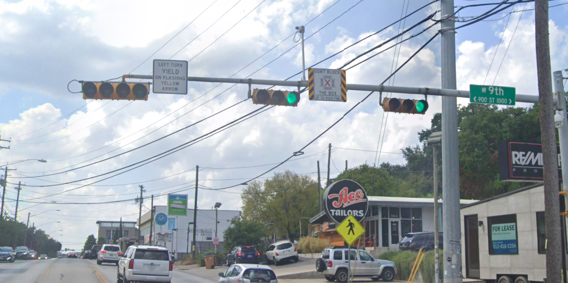
Austin Transportation Department Signs Work Orders
Created By: Susanne Gov Created Date: 2020-08-10 Location Name: LAMAR BLVD / 9TH ST Intersection ID: 5155448 Cardinal Direction: S
Sign Type | Install/Remove
Left Turn Yield Flashing Yellow | Remove
Street Name Sign | Install
Don’t Block the Box | Install

Slide 3
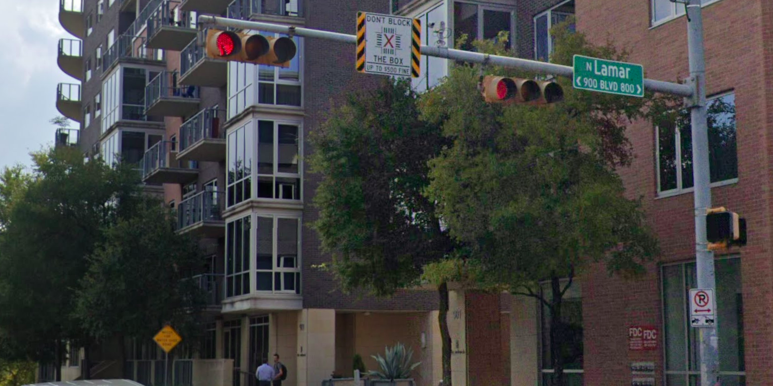
Austin Transportation Department Signs Work Orders
Created By: Susanne Gov Created Date: 2020-08-10 Location Name: LAMAR BLVD / 9TH ST Intersection ID: 5155448 Cardinal Direction: E
Sign Type | Install/Remove
Street Name Sign | Install
Don’t Block the Box | Install

Slide 4
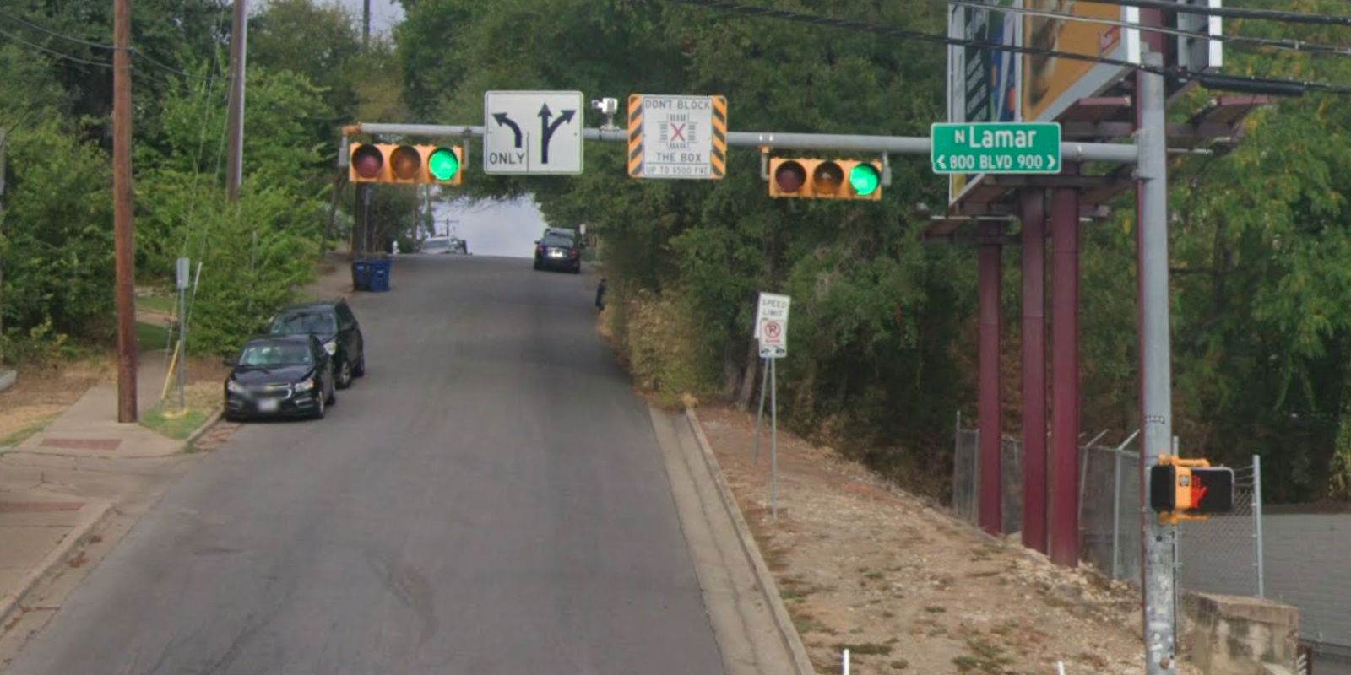
Austin Transportation Department Signs Work Orders
Created By: Susanne Gov Created Date: 2020-08-10 Location Name: LAMAR BLVD / 9TH ST Intersection ID: 5155448 Cardinal Direction: W
Sign Type | Install/Remove
Left Turn Arrow Only | Install
Street Name Sign | Install
Don’t Block the Box | Install
Straight Right Arrow | Install

